Slide 1

Bachelor’s of Technology in EXTC
Project Phase- I, Approval Presentation
Academic Year 2024-25
Semester VII
SVKM’s NMIMS
Mukesh Patel School of Technology Management and Engineering, Vile Parle, Mumbai- 400056
Department of Electronics & Telecommunication

Slide 2
A PRESENTATION ON
“EVision - Smart Charging Forecasting & Location Planner”
By
Under the guidance of
PROJECT MENTOR NAME
Prof./Dr. Anjana Rodrigues
Yash Joshi | D065 | 70062200095
Tirth Dhandhukia | D058 | 70062200012

Slide 3
Table of Contents
Slide No. | Section | Updated Content
1 | Title Slide | Evision-Smart EV Charging Forecasting & Location Planner
2 | Project Objective | Concise 2–3 sentence objective with SARIMA, XGBoost, GIS-based clustering, interactive dashboard
3 | Introduction | EV adoption challenges, underutilized infrastructure, reactive planning
4 | Motivation | EV boom, grid overload, need for predictive planning
5 | Problem Statement | Lack of integrated forecasting and site recommendation
6 | Literature Survey | Individual tables comparing 6 research papers with improvements
7 | Flow Diagram / Architecture | Methodology steps with clear diagram
8 | Software Requirements | Python ML backend + JavaScript frontend, tools table, functional flowchart
9 | Methodology | SARIMA, XGBoost, clustering advantages vs. limitations
10 | Applications | Urban planning, fleet optimization, societal benefits, government/private initiatives
11 | Acknowledgement | Mentor, department, references
12 | References | IEEE-style references for cited papers

Slide 4
Objectives
Develop an AI-powered forecasting system to predict future EV charging demand across different city regions.
Leverage advanced models – XGBoost, and K-Means clustering – for accurate time-series and spatial analysis.
Identify high-demand hotspots and recommend optimal locations for new charging stations.
Provide an interactive web dashboard with geospatial visualizations, demand forecasts, and decision-making insights.
Enable data-driven planning for urban developers, EV operators, and policymakers to optimize infrastructure and reduce grid overload.

Slide 5
Introduction
Rapid adoption of Electric Vehicles (EVs) is creating high and unpredictable charging demand in cities.
Existing charging infrastructure often suffers from poor placement, grid overload, and low utilization.
Lack of real-time intelligence leads to inefficient investments and customer dissatisfaction.
Proposed Solution:
  An AI-powered Geo-Intelligent System that combines time-series forecasting and geospatial clustering.
  Predicts where and when EV charging demand will rise.
  Helps planners and operators strategically deploy new charging stations.
Supports smart city development and green mobility goals through data-driven decision-making.

Slide 6
Motivation
EV boom is reshaping urban transportation, but charging infrastructure is not keeping pace.
Poorly placed charging stations cause:
  Underutilization in some areas
  Grid overload & long queues in others
City planners and EV operators lack predictive tools to make informed site selection decisions.
Current methods are reactive and data-siloed, leading to inefficient investments.
Need: A smart, data-driven solution that predicts future demand and recommends optimal charging station locations, ensuring efficient energy distribution and user satisfaction.

Slide 7
Literature Survey:
Table 1 – Comparison with S. Sanami et al. (2023)
Aspect | Existing Paper | Our Project
Technique | Multivariate Time-Series Analysis | SARIMA + XGBoost hybrid model
Scope | Only demand forecasting | Demand forecasting + site recommendation
Spatial Intelligence | Not included | GIS data + K-Means clustering for hotspot detection
Deployment | Academic model, no dashboard | Real-time web-based dashboard for decision-making
Notes:
SARIMA-Captures both short-term patterns (via ARIMA) and long-term seasonality (via seasonal components).

Slide 8
Table 2 – Comparison with M. van Etten et al. (2024)
Aspect | Existing Paper | Our Project
Technique | Global Time Series Modeling | Localized SARIMA + XGBoost
Granularity | Large-scale generalized demand | City/region-specific predictions
Spatial Hotspots | Not addressed | K-Means clustering for localized hotspots
Actionability | Provides demand curves only | Actionable site recommendations with scoring system

Slide 9
Table 3 – Comparison with S. Patsavellas et al. (2022)
Aspect | Existing Paper | Our Project
Technique | Regression and statistical models | SARIMA + XGBoost hybrid model
Model Accuracy | Limited for non-linear trends | Captures non-linear residuals, improving accuracy
Spatial Clustering | Not included | Integrated GIS-based hotspot analysis
Dashboard | No real-time visualization | Interactive geospatial web dashboard

Slide 10
Table 4 – Comparison with S. K. Nayak et al. (2021)
Aspect | Existing Paper | Our Project
Technique | Traditional time-series models | SARIMA + XGBoost
Forecast Scope | Short-term power consumption | Short- & long-term (12 months) forecasts
Non-linear Patterns | Poor handling of fluctuations | Captures complex demand patterns using ML
Spatial Features | Not included | GIS-based clustering and hotspot detection

Slide 11
Table 5 – Comparison with S. Zhang et al. (2023)
Aspect | Existing Paper | Our Project
Technique | Climate-aware time-series forecasting | Hybrid SARIMA + ML with spatial data
Focus | Impact of climate on charging demand | Multi-factor approach (traffic, EV density, grid support)
Spatial Hotspots | Not highlighted | K-Means clustering for hotspot identification
Recommendation | Predictive analysis only | Optimal site selection with scoring mechanism

Slide 12
Problem statement
Rapid EV adoption is straining current charging infrastructure, leading to grid overload, long wait times, and underutilized stations.
Existing planning methods rely on historical data and manual surveys, making them reactive and inefficient.
Most research focuses only onsite selection or only on demand forecasting, not both together.
Lack of an AI-powered tool that combines time-series demand forecasting with spatial analysis for data-driven decision-making.
Urban planners and EV operators cannot accurately predict where future charging demand will surge, leading to poor ROI and inconvenient user experience.

Slide 13
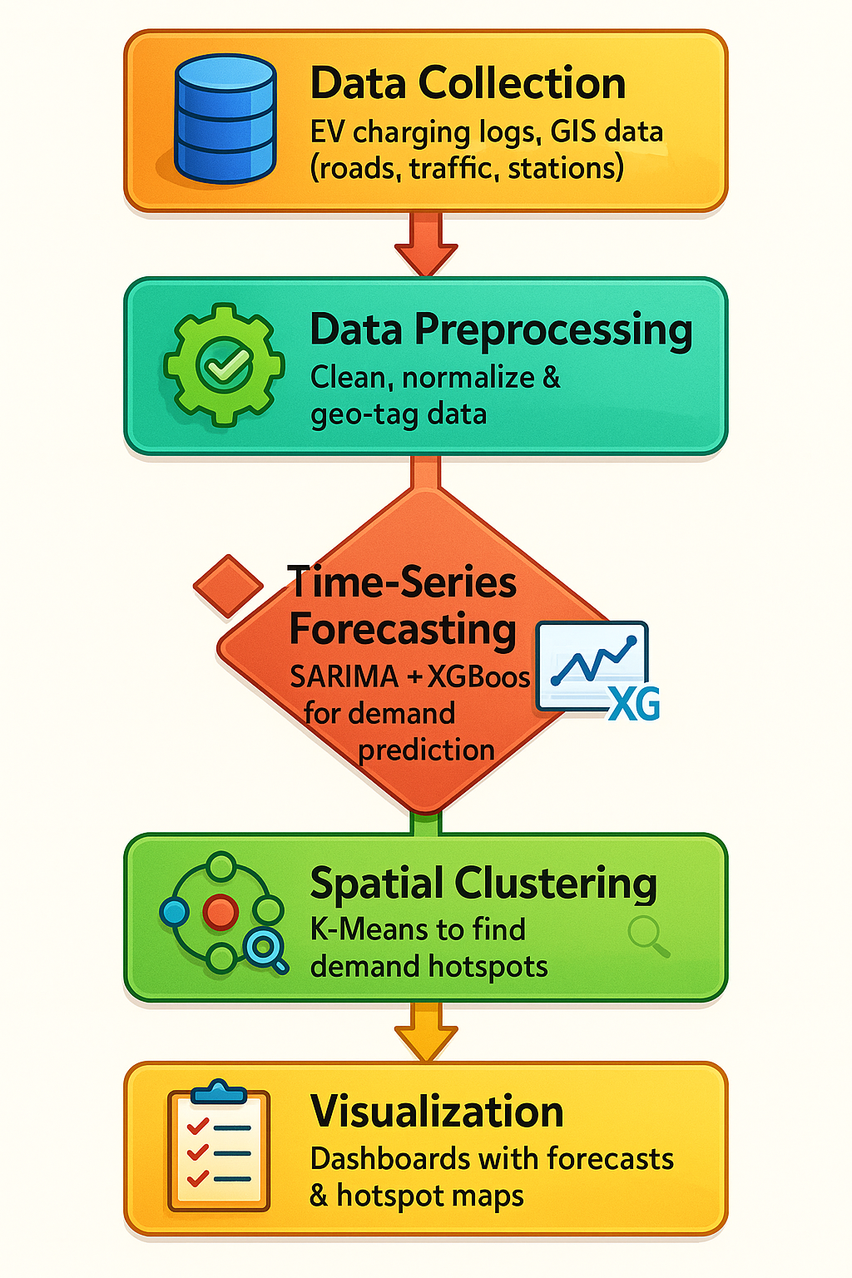
Block Diagram of Project/Flowchart

Slide 14
Software Requirements
Frontend Development: JavaScript (React.js / Vanilla JS)
Data Processing & ML Models: Python (Pandas, NumPy)
Time-Series Modeling: Statsmodels (SARIMA), XGBoost
Clustering: Scikit-learn (K-Means)
Geospatial Visualization: GeoPandas, Google Maps API (optional)
Database: SQLite
Visualization:.Powerbi for web dashboards

Slide 15
Methodology
Data Collection:
  Historical EV charging data (usage patterns, timestamps, and locations).
  GIS data for roads, traffic density, and existing stations.
Data Preprocessing:
  Handle missing values, normalize data, and extract relevant features.
  Geo-tagging of data for spatial analysis.
Time-Series Forecasting:
  Use SARIMA to model seasonal and trend-based patterns in charging demand.
  Apply XGBoost for capturing non-linear residuals, improving accuracy.
Spatial Clustering:
  Use K-Means clustering on geo-features (EV density, traffic, grid capacity) to identify demand hotspots.
Scoring & Recommendation:
  Rank candidate locations based on forecasted demand, accessibility, and grid support.
  Generate top-N site recommendations.
Visualization:
  Interactive JavaScript dashboard and Power BI dashboard with demand forecast graphs and hotspot maps.

Slide 16
Applications
Urban Planning & Infrastructure Deployment
Helps city planners and EV operators forecast where new charging stations are needed most, enabling data-driven investments.
Fleet Charging Optimization
Enables e-rickshaw and delivery fleet companies to preemptively position infrastructure where demand spikes.
Energy Grid Load Management
Forecasts help power utilities anticipate load and mitigate grid stress during peak EV charging hours.
Commercial Site Selection
Retailers and businesses make informed decisions about deploying charging as value-added customer service.

Slide 17
References
S. Sanami, F. Biral and J. M. Bass, “Demand Forecasting for Electric Vehicle Charging Stations using Multivariate Time-Series Analysis,” IEEE Access, vol. 11, pp. 54160-54174, 2023.
M. van Etten, P. Holvoet, W. Joosen and T. Verbelen, “Large-Scale Forecasting of Electric Vehicle Charging Demand Using Global Time Series Modeling,” IEEE Transactions on Smart Grid, vol. 15, no. 1, pp. 789-799, Jan. 2024.
S. Patsavellas and T. Salonitis, “Forecasting Electric Vehicle Charging Demand in Smart Cities,” Energies, vol. 15, no. 2, pp. 875-890, Jan. 2022.
S. K. Nayak, S. K. Padhy and B. K. Panigrahi, “Power consumption prediction for electric vehicle charging stations using time series models,” Energy, vol. 237, pp. 121523, Jan. 2021.
S. Zhang, Q. Shi, Y. Zhang, Q. Liu and H. Endo, “Electric vehicle charging demand forecasting at charging stations considering climate influences,” Energy, vol. 295, 2023, Art. no. 117198.
A. Zeydan and M. Uzar, “Short-Term Forecasting of Electric Vehicle Load Using Machine Learning Techniques,” International Journal of Electrical Power & Energy Systems, vol. 130, pp. 106939, July 2021.

Slide 18
Acknowledgement
We would like to express our heartfelt thanks to everyone who has supported us during the initial stages of our capstone project:
Prof. Anjana Rodrigues, our Project Mentor and Project In-Charge, for her continuous guidance, motivation, and valuable inputs during the planning and conceptualization phase.
Dr. Avanish More, Head of the Department, for providing us with the opportunity and resources to undertake this project.
We also acknowledge the authors and organizations whose open-source research papers and technical documents—accessed from platforms like IEEE Xplore and MDPI—have helped us build a strong foundation for our work.
We look forward to continued support as we progress toward the successful execution of our project.

Slide 19
THANK YOU

